Slide 1
5.2 Modify Administrator Account
As a/n Administrator,Account,Data Analyst I would like to an option to modify my account
Donation Solution
Class Diagram
Administrator Account
Id : Integer First_name : varchar Last_name : varchar Email : varchar Phone : varchar Street1 : varchar Street2 : varchar City : varchar State: varchar Zip_Code : varchar
construct() RequestLogin() requestLogOut() showFailMessage() requestAuthentication() Authenticate()
Home Page
Donation Instruction: String Activities board: List OrganizationDescription: String
construct() LoadInformationFromDB() ShowMofication() showActivity()
Log in
Authenticate

Slide 2
6.1 Verify Donation Items
As a/an Administrator, I would like to verify the quality and quantity of items
Donation Solution
Class Diagram
Verify Donation List
Donation List Verification: String
construct() LoadInformationFromDB() ShowDonationList() verification() RequestAuthentication() Authenticate()

Slide 3
6.2 Generate Donation Value Estimate
As a/an Administrator I want to manually update the donation value whenever I log in
Donation Solution
Class Diagram
Validation and Evaluation
DonationListVerification: String DonationValue: Float OrganizationDescription: String
construct() LoadInformationFromDB() ShowOrganizationDescription() requestAuthentication() Authenticate() showActivity()

Slide 4
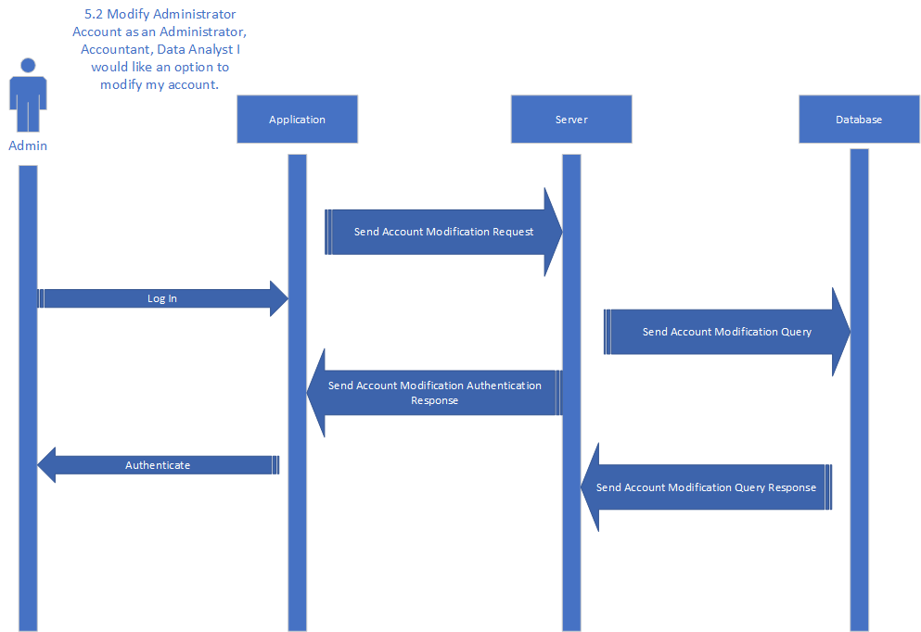

Slide 5


Slide 6
